Slide 1
Chapter
5
IT Infrastructure: Hardware and Software
Notes:
There are two video cases available for this chapter:
Case 1: Rockwell Automation fuels the oil and gas industry with the Internet of Things (IoT)
Case 2: ESPN.com: Getting to eXtreme Scale On the Web

Slide 2
Essentials of Management Information Systems
Chapter 5 IT Infrastructure: Hardware and Software
LEARNING OBJECTIVES
What are the components of IT infrastructure?
What are the major computer hardware, data storage, input, and output technologies used in business and major hardware trends?
What are the major types of computer software used in business and major software trends?
What are the principal issues in managing hardware and software technology?

Slide 3
Essentials of Management Information Systems
Chapter 5 IT Infrastructure: Hardware and Software
VIDEO CASES AND LEARNING TRACKS
Learning Tracks
How Computer Hardware and Software Work
Service Level Agreements
Cloud Computing
The Open Source Software Initiative
The Evolution of IT Infrastructure
Technology Drivers of IT Infrastructure
Video Cases
Case 2: ESPN.com: Getting to eXtreme Scale On the Web
Case 1: Rockwell Automation fuels the oil and gas industry with the Internet of Things (IoT)
Instructional Video 1: IBM Blue Cloud Is Ready-to-Use Computing

Slide 4
Essentials of Management Information Systems
Chapter 5 IT Infrastructure: Hardware and Software
Toyota Motor Europe Reaches for the Cloud
Problem: Providing a consistent maintenance service to millions of customers
Solution: Cloud-based computing service that manages onboard computers in Toyota vehicles
Demonstrates IT’s role in reducing costs and improving security and customer service

Slide 5
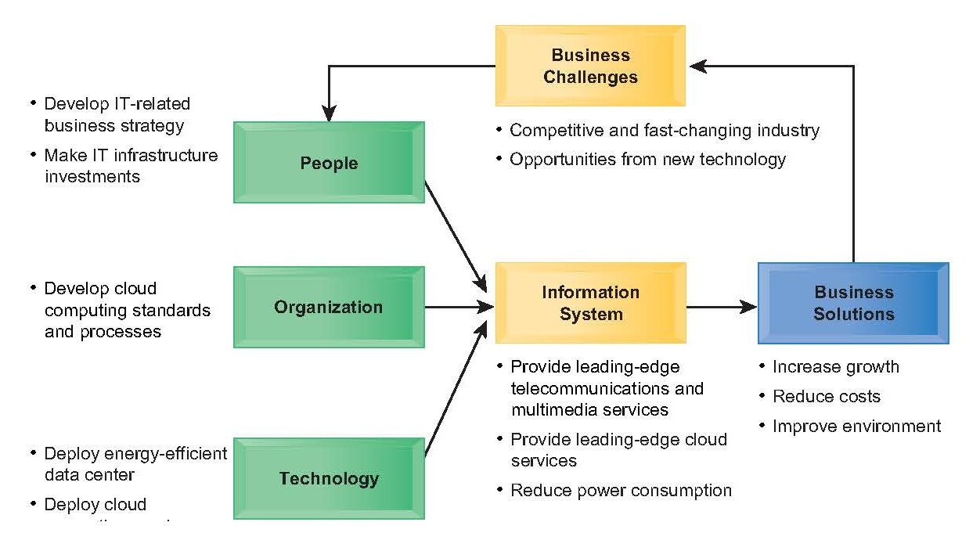
Essentials of Management Information Systems
Chapter 5 IT Infrastructure: Hardware and Software
Toyota Motor Europe Reaches for the Cloud
Notes:
New slide

Slide 6
Essentials of Management Information Systems
Chapter 5 IT Infrastructure: Hardware and Software
What are the components of IT infrastructure?
Infrastructure Components
IT infrastructure: provides platform for supporting all information systems in the business
  Computer hardware
  Computer software
  Data management technology
    Organizes, manages, and processes business data concerned with inventory, customers, and vendors
    Data centers
  Networking and telecommunications technology
  Technology services
    E.g., consultants for systems integration with legacy systems
Notes:
It may be hard to students to think of a business having “computer infrastructure.” A good parallel is the infrastructure of a building which would include the electrical and plumbing systems, along with a telephone network. Students are familiar with these types of infrastructure. Like these other kinds of infrastructure, IT infrastructure may not be visible to the casual employee, but it plays a vital role in the life of the business. Without it, there would be no business typically.

Slide 7
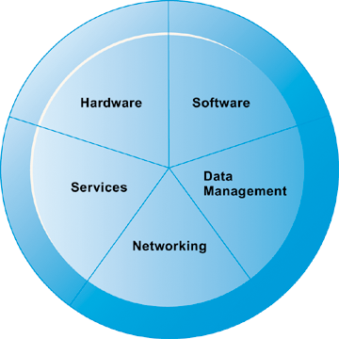
Essentials of Management Information Systems
Chapter 5 IT Infrastructure: Hardware and Software
What are the components of IT infrastructure?
IT Infrastructure Components
A firm’s IT infrastructure is composed of hardware, software, data management technology, networking technology, and technology services.
Figure 5.1

Slide 8
Essentials of Management Information Systems
Chapter 5 IT Infrastructure: Hardware and Software
What are the major computer hardware, data storage, input, and output technologies
used in business and the major hardware trends?
Types of Computers
Computers come in different sizes with varying capabilities for processing information
Personal computers
Mobile devices (smartphones, tablets)
Workstations
  More powerful mathematical and graphics-processing capabilities than a PC
Notes:
Most students do not think of their cell phones as computers. Yet cell phones have powerful, energy-efficient processor chips that use very little power, an operating system, and application software (including games). Of course smartphones like iPhone and BlackBerry and others truly are computer systems that also are telephones. Today’s smartphones are far more powerful than the early PCs of the 1980s. The more appropriate term for smartphones is “media and entertainment devices” as Steve Jobs often referred to the iPhone and iPad.
90 percent of the billion cell phones shipped each year use some version of ARM (Advanced RISC Machine) chips, licensed by ARM Inc. and manufactured by many firms. For instance, Apple’s latest 4G iPhone uses a dual core AR-architecture chip designed by Apple and manufactured by Samsung. The chip set operates at 1 gigahertz, and uses only .55 milliwatts of power (compared to a typical laptop dual core mobile Intel processor that uses 25 watts—about 500 times more power consumption). Smartphones do not need fans. Cellphones do not use power hungry hard drives but instead use flash memory chips with storage of up to 32 gigabytes. Whereas the latest Energy Star 4 laptop disk drives consume 500 milliwatts at idle, and 1 watt writing and reading, flash memory chips consume about 50 milliwatts writing and reading data (twenty times less power).

Slide 9
Essentials of Management Information Systems
Chapter 5 IT Infrastructure: Hardware and Software
What are the major computer hardware, data storage, input, and output technologies
used in business and the major hardware trends?
Types of Computers
Servers:
  Support computer network, sharing files and resources.
  Provide hardware platform for e-commerce.
Mainframes:
  Large-capacity, high-performance computer that can process large amounts of data very rapidly
  E.g., used by airlines to handle thousands of reservations per second
Notes:
Ask students if they have heard about, or know about, servers and mainframes. Some students in your class might have direct experience working with servers as network administrators, or as technicians. Most will not have experience with mainframe computers. Be sure to point out that mainframes are still a major revenue and profit source for IBM, one of the last large-scale commercial manufacturers of mainframe computers. They are used often as huge Web servers where they are more efficient than tens of thousands of PCs in processing large volumes of records.

Slide 10
Essentials of Management Information Systems
Chapter 5 IT Infrastructure: Hardware and Software
What are the major computer hardware, data storage, input, and output technologies
used in business and the major hardware trends?
Types of Computers
Supercomputer:
  More sophisticated computer used for tasks requiring extremely rapid and complex calculations with thousands of variables, millions of measurements
  Used in engineering, scientific simulations, military/weapons research, weather forecasting
Grid computing:
  Power of geographically remote computers connected into single network to act as “virtual supercomputer”
Notes:
In the past, supercomputers used custom designed chips (processors) and RAM memory chips, all very densely packed, to achieve very high speeds of computation. The most common, and some of the largest, supercomputers today are often made up of tens of thousands of Intel Pentium or multicore processors which are relatively inexpensive. Google has one of the largest civilian computing systems in the world that deals with supercomputer-level amounts of data, and yet is built from nearly one million PCs working together.
Grid computing is similar to utility computing in the sense of sharing the resources of many computers. But grid computing usually involves teaming up remote computers to focus on solving the same problem or parts of the same task. Students can participate in a kind of Internet grid computing program called SETI (http://setiathome.berkeley.edu/). SETI@home is a scientific experiment that uses Internet-connected computers in the Search for Extraterrestrial Intelligence (SETI). Students can participate by running a free program that downloads and analyzes radio telescope data.

Slide 11
Essentials of Management Information Systems
Chapter 5 IT Infrastructure: Hardware and Software
What are the major computer hardware, data storage, input, and output technologies
used in business and the major hardware trends?
Types of Computers
Client/server computing:
  Form of distributed computing
  Splits processing between “clients” and “servers”
  Clients: user point of entry
  Servers: store and process shared data and perform network management activities
Notes:
You may want to spend some time explaining carefully client/server computing because it is the dominant model of computing and has been since the 1990s. The Web is a very large example of client/server computing. The client/server model of computing is based on inexpensive PC microprocessors. Server architecture allows data centers to scale up as need by simply adding more servers (or increasing the processing power of existing servers by moving to dual and quad core processors). Clients are the interface between system and user.

Slide 12
Essentials of Management Information Systems
Chapter 5 IT Infrastructure: Hardware and Software
What are the major computer hardware, data storage, input, and output technologies
used in business and the major hardware trends?
Types of Computers
Client/server computing (cont.):
  Two-tiered client/server architecture
    Uses two types of machines
  Multi-tiered client/server architecture (N-tier)
    Balances load of network over several levels of servers
    E.g., Web servers and application servers

Slide 13
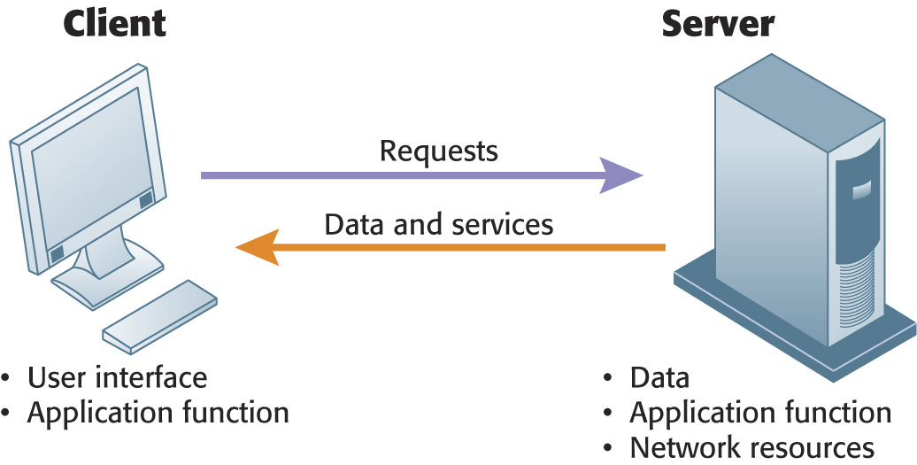
Essentials of Management Information Systems
Chapter 5 IT Infrastructure: Hardware and Software
What are the major computer hardware, data storage, input, and output technologies
used in business and the major hardware trends?
Client/Server Computing
In client/server computing, computer processing is split between client machines and server machines linked by a network. Users interface with the client machines.
Figure 5.2
Notes:
You might point out to students the confusion that results from the word “server.” A server is a physical computer. It’s also the software that runs on that computer which “serves” user requests. The intended meaning often comes from the context in which it is used. If someone says we had to “purchase a number of servers,” it usually means the purchase of computers. When people say “the server is down” they usually mean the computer is down. However, a Web page server is a piece of software.

Slide 14
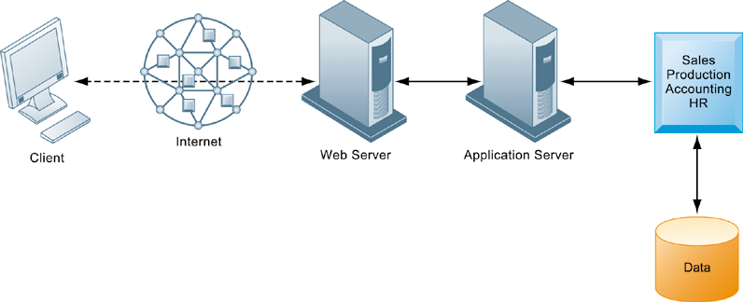
Essentials of Management Information Systems
Chapter 5 IT Infrastructure: Hardware and Software
What are the major computer hardware, data storage, input, and output technologies
used in business and the major hardware trends?
A Multitiered Client/Server Network (N-Tier)
In a multitiered client/server network, client requests for service are handled by different levels of servers.
Figure 5.3
Notes:
Corporations and even small firms usually separate the application processing (usually a database application) from the Web page server function. Although not necessarily on different physical servers, often this separation does involve a separate physical server for applications.

Slide 15
Essentials of Management Information Systems
Chapter 5 IT Infrastructure: Hardware and Software
What are the major computer hardware, data storage, input, and output technologies
used in business and the major hardware trends?
Storage, Input, and Output Technology
Primary secondary storage technologies
  Magnetic disk:
    Hard drives, USB flash drives
    Solid state drives (SSDs)
  Optical disks
    CD-ROM, CD-RW, DVD, DVD-RW
  Magnetic tape
  Storage networking: SANs
    Connect multiple storage devices on a separate high-speed network dedicated to storage
Notes:
The cost of digital storage has fallen exponentially along with the cost of computing. Today, an 32 gigabyte USB “Flash Drive” costs about $12. You might ask students what impact they think this might have on the amount of digital information stored in corporations. Or ask students how many gigabytes of information they use to store photos, music, videos, podcasts, and other digital material. On average in 2015, Americans consume an estimated 35 gigabytes of digital information a day. Ask students if they can imagine themselves consuming that much digital information. Ask them to help you make a list of the digital information sources they use in a day. Try to estimate how large are the files they routinely use for music, video, advertising, browsing the Web and using search engines. The biggest digital files are video files.

Slide 16
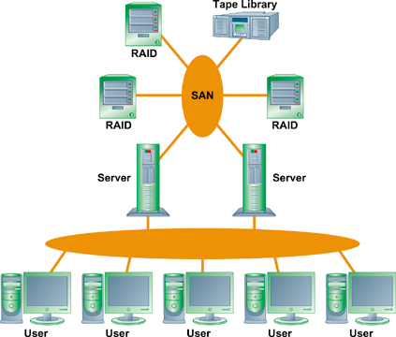
Essentials of Management Information Systems
Chapter 5 IT Infrastructure: Hardware and Software
What are the major computer hardware, data storage, input, and output technologies
used in business and the major hardware trends?
A Storage Area Network (SAN)
A typical SAN consists of a server, storage devices, and networking devices, and is used strictly for storage. The SAN stores data on many different types of storage devices, providing data to the enterprise. The SAN supports communication between any server and the storage unit as well as between different storage devices in the network.
Figure 5.4
Notes:
SANs are an effort by corporations to reduce storage costs, manage information, increase flexibility, and provide near-certain backup. One of the major worries of business firms is losing customer or other digital data. Extraordinary efforts are taken to make redundant copies of digital information, and placing it on separate secure servers, even remote servers in separate facilities.

Slide 17
Essentials of Management Information Systems
Chapter 5 IT Infrastructure: Hardware and Software
What are the major computer hardware, data storage, input, and output technologies
used in business and the major hardware trends?
Storage, Input, and Output Technology
Input devices:
  Gather data and convert them into electronic form.
    Keyboard, computer mouse, touch screen, pen-based input, optical character recognition, magnetic ink character recognition, digital scanner, audio input, sensors
Output devices:
  Display data after they have been processed
    Monitor (flat-panel, CRT)
    Printer (impact, nonimpact)
    Audio output
Notes:
Ask if students can think of other ways information gets into computers. How about cell phone cameras?

Slide 18
Essentials of Management Information Systems
Chapter 5 IT Infrastructure: Hardware and Software
What are the major computer hardware, data storage, input, and output technologies
used in business and the major hardware trends?
Contemporary Hardware Trends
The mobile digital platform
  Mobile devices, smartphone
  Netbooks and tablet computers
  E-book readers
Consumerization of IT
  New technology that emerges in consumer market spreads into business organizations
  BYOD (bring your own device): business use of personal mobile devices
Notes:
Talk to students about how they are using their cell phones. Are they listening to online radio stations, streaming music and videos, or mostly just texting? Do they shop, and do some buy? What do they buy– digital goods or retail goods like at Amazon? How use apps to purchase? Ask them to think about how this new mobile platform might influence how a business is run, or how it is managed.

Slide 19
Essentials of Management Information Systems
Chapter 5 IT Infrastructure: Hardware and Software
Wearable Computers Go to Work
Interactive Session: Management
The Greening of the Data Center
Read the Interactive Session and then discuss the following questions:
What business and social problems does data center power consumption cause?
What solutions are available for these problems? Are they management, organizational, or technology solutions? Explain your answer.
What are the business benefits and costs of these solutions?
Should all firms move toward green computing? Why or why not?
Notes:
How many students have tried FitBit or other wearable computers?

Slide 20
Essentials of Management Information Systems
Chapter 5 IT Infrastructure: Hardware and Software
What are the major computer hardware, data storage, input, and output technologies
used in business and the major hardware trends?
Contemporary Hardware Trends
Nanotechnology
  Uses individual atoms and molecules to create computer chips and other devices thousands for times smaller than current technologies
Quantum computing
  Uses principles of quantum physics to represent data and perform operations on the data
  Enables processing times that are millions of times faster than current high-speed processing
Notes:
Quantum physics, or quantum mechanic, studies the behavior of physical matter at microscopic scales, in which energy and matter behave as both waves and particles.

Slide 21
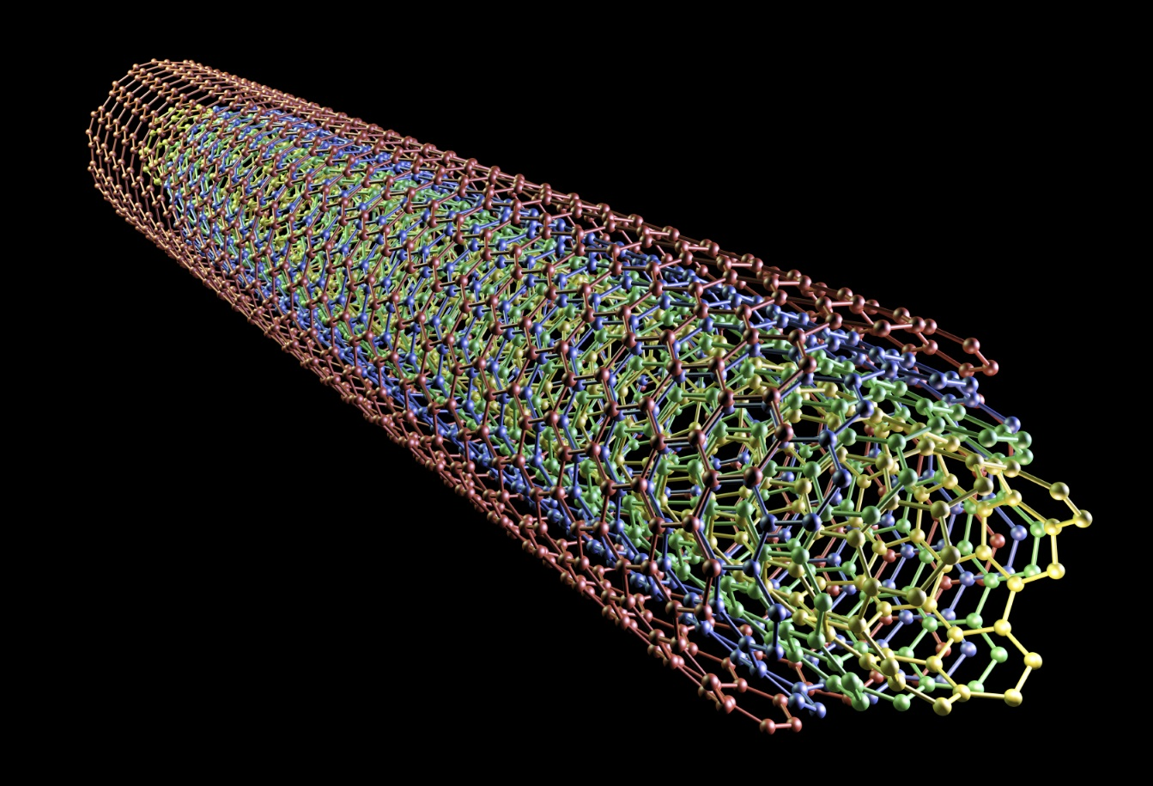
Essentials of Management Information Systems
Chapter 5 IT Infrastructure: Hardware and Software
What are the major computer hardware, data storage, input, and output technologies
used in business and the major hardware trends?
Examples of Nanotubes
Nanotubes are tiny tubes about 10,000 times thinner than a human hair. They consist of rolled up sheets of carbon hexagons, have potential uses as minuscule wires or in ultrasmall electronic devices, and are very powerful conductors of electrical current.
Notes:
Nanotechnology is the study of the controlling of matter on an atomic and molecular scale. Generally, nanotechnology deals with structures of the size 100 nanometers or smaller. Nanotechnology is used to create transistors of the tiny size previously mentioned. Can students describe any other applications of this type of technology (for example, medical)?

Slide 22
Essentials of Management Information Systems
Chapter 5 IT Infrastructure: Hardware and Software
What are the major computer hardware, data storage, input, and output technologies
used in business and the major hardware trends?
Contemporary Hardware Trends
Virtualization
  Process of presenting a set of computing resources so they can be accessed in ways that are unrestricted by physical configuration or geographic location
  Enables single physical resource to appear to the user as multiple resources
  Enables companies to host multiple systems on single machine
Notes:
The term “virtualization” is so widely used that it can be confusing. Virtualization has an “as if” quality to it. There are virtual machines that are software “machines” which act as if they were a real physical computer (executes instructions like the physical machine it emulates). IBM’s mainframes run tens of thousands of separate instances of Windows or Linux on a single large mainframe computer, giving users the impression they have their own dedicated computer. Server computers can be virtualized to run multiple instances of an operating system also giving users the feeling they have their own computer. Virtualized computers are much more efficient than a typical non-virtualized computer because they can be executing multiple jobs nearly simultaneously. Virtual memory is memory which fools the processor into thinking it is hardware memory but in fact is memory located on a hard drive.

Slide 23
Essentials of Management Information Systems
Chapter 5 IT Infrastructure: Hardware and Software
What are the major computer hardware, data storage, input, and output technologies
used in business and the major hardware trends?
Contemporary Hardware Trends
Cloud computing:
  A model of computing in which firms and individuals obtain computing resources over the Internet
    Cloud infrastructure as a service (IaaS)
    Cloud platform as a service
    Cloud software as a service (SaaS)
  Public vs. private clouds
  Utility computing, on-demand computing
  Data storage security is in hands of provider
Notes:
Both grid computing and cloud computing allow organizations to optimize their use of resources in new ways. Grid computing allow corporations to take advantage of spare computing power in the form of networked virtual supercomputers, and cloud computing allows organizations to avoid the expenses of maintaining their own hardware and software, relying on the cloud instead. Refer students to the Cloud Computing Learning Track on the Web site.

Slide 24
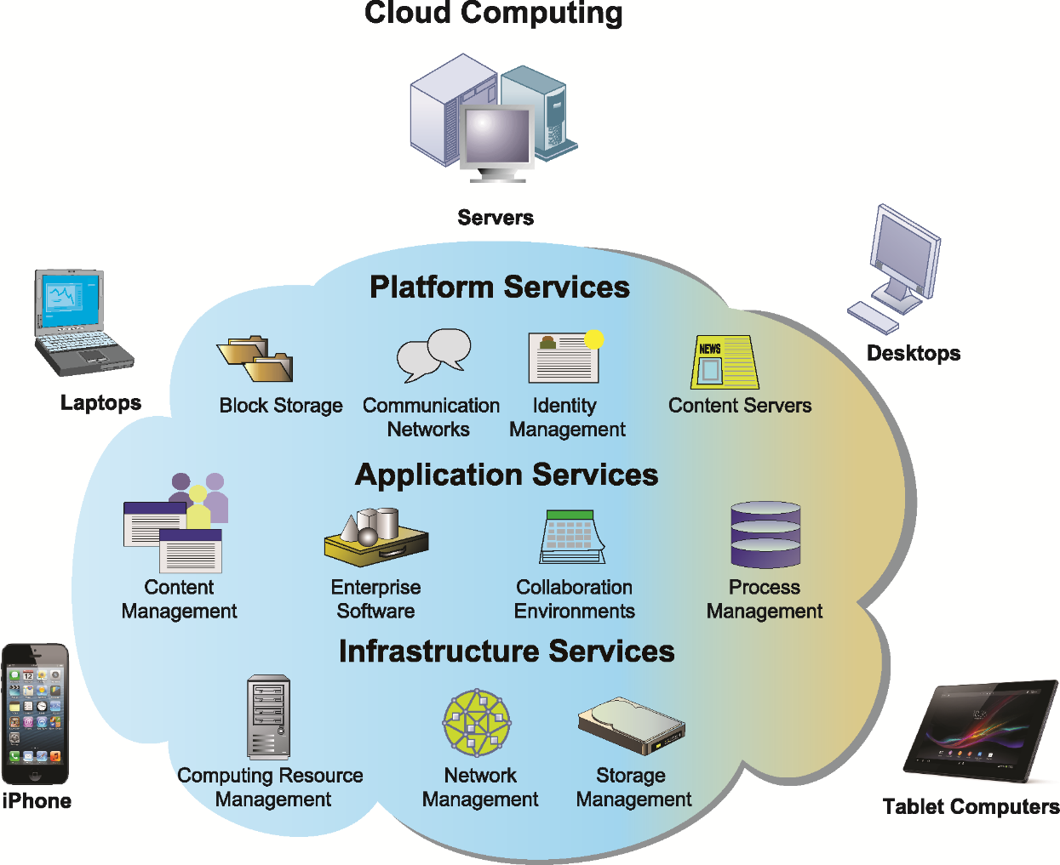
Essentials of Management Information Systems
Chapter 5 IT Infrastructure: Hardware and Software
What are the major computer hardware, data storage, input, and output technologies
used in business and the major hardware trends?
Cloud Computing Platform
In cloud computing, hardware and software capabilities are provided as services over the Internet. Businesses and employees have access to applications and IT infrastructure anywhere at any time using an Internet-connected device.
Figure 5.5
Notes:
The largest operators of cloud computing data centers are Amazon, IBM, Oracle, HP, Apple, and Google.

Slide 25
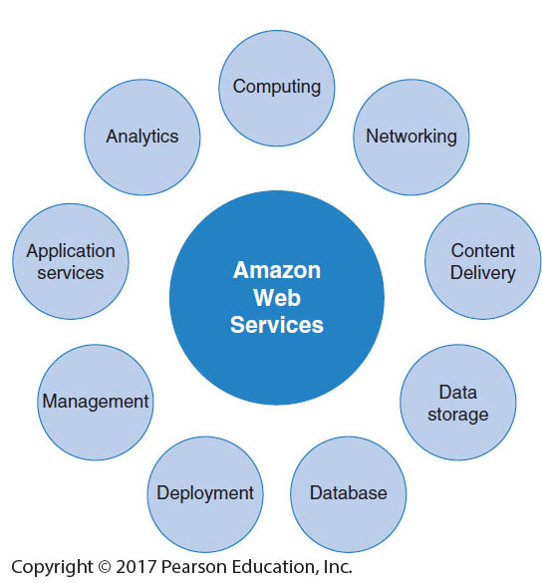
Essentials of Management Information Systems
Chapter 5 IT Infrastructure: Hardware and Software
What are the major computer hardware, data storage, input, and output technologies
used in business and the major hardware trends?
Amazon Web Services
(AWS) is a collection of web services that Amazon provides
to users of its cloud platform. AWS is
the largest provider of
cloud-based services in the United States.
Figure 5.6

Slide 26
Essentials of Management Information Systems
Chapter 5 IT Infrastructure: Hardware and Software
Cloud Computing Is the Future
Interactive Session:
Cloud Computing Is the Future
Read the Interactive Session and then discuss the following questions:
What business benefits do cloud computing services provide? What problems do they solve?
What are the disadvantages of cloud computing?
What kinds of businesses are most likely to benefit from using cloud computing? Why?

Slide 27
Essentials of Management Information Systems
Chapter 5 IT Infrastructure: Hardware and Software
What are the major computer hardware, data storage, input, and output technologies
used in business and the major hardware trends?
Contemporary Hardware Trends
Green computing
  Practices and technologies for designing, making, using, and disposing of computer hardware to reduce environmental impact
  Key priority is power reduction
  IT in U.S. provides 2% of U.S. power demand and 2% of world’s greenhouse gases
Notes:
Chapter 1 Case 2 Google Data Center Efficiency provides a good introduction to this topic. Today’s chips are much more power efficient than in the past, but still require cooling fans in PCs and laptops. Smartphones do not have fans, but heat sinks to dissipate the processor heat to the frame of the phone. According to a study by the National Resources Defense Council (NRDC), all data centers in the US consume 91 billion kilowatt hours a year in 2014, about 34 power plants putting out 500 megawatts each. Large mega-sized cloud centers consume only 5% of this load, and are the most efficient forms of computing. The problem is the 95% of smaller data centers that are very inefficient.

Slide 28
Essentials of Management Information Systems
Chapter 5 IT Infrastructure: Hardware and Software
What are the major computer hardware, data storage, input, and output technologies
used in business and the major hardware trends?
Contemporary Hardware Trends
High-performance and power-saving processors
  Multicore processor:
    Integrated circuit with two or more processors
    Enhanced performance and reduced power consumption
  Power-efficient processors
    Low power consumption essential in mobile computing.
Notes:
Multicore processors are the major way computer manufacturers today can increase speed and power. When all processing is done by a single chip, power leakage and heat increase as processor speed is increased. These limitations are avoided by spreading the load across two or more processors operating at slower speeds but which together can get the job done faster than a single high speed chip.

Slide 29
Essentials of Management Information Systems
Chapter 5 IT Infrastructure: Hardware and Software
What are the major computer hardware, data storage, input, and output technologies
used in business and the major hardware trends?
Contemporary Hardware Trends
Autonomic computing:
  Development of systems that can configure themselves, heal themselves; e.g., self-updating antivirus software
Notes:
Most students have unwittingly used autonomic computing: whenever Microsoft or other software company updates your PC online automatically it is a kind of autonomic computing. A more pure form would be if your operating system could call out to the cloud when it faced a shutdown and ask for help in restoring its functionality.

Slide 30
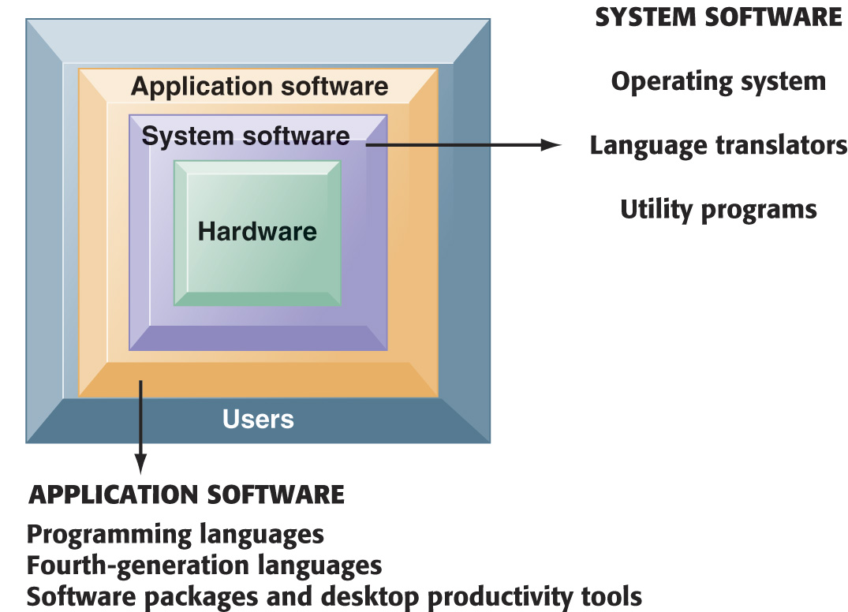
Essentials of Management Information Systems
Chapter 5 IT Infrastructure: Hardware and Software
What are the major types of computer software used in business and the major software trends?
The Major Types of Software
The relationship among the system software, application software, and users can be illustrated by a series of nested boxes. System software—consisting of operating systems, language translators, and utility programs—controls access to the hardware. Application software, including programming languages and “fourth-generation” languages, must work through the system software to operate. The user interacts primarily with the application software.
Figure 5.7
Notes:
You might ask students why a Microsoft application like Word cannot be installed on both PCs and Macintosh computer? Why is it that users are forced to buy different software application software for different devices? A part of the answer is the close interdependency of hardware, operating systems, and application software.

Slide 31
Essentials of Management Information Systems
Chapter 5 IT Infrastructure: Hardware and Software
What are the major types of computer software used in business and the major software trends?
Operating System Software
The software that controls computer activities
GUIs and multitouch
PC operating systems
  Windows (Windows 8)
  Mac (OSX Lion)
  UNIX
  Linux (open source)
Mobile operating systems
  Chrome, Android, iOS
Notes:
PC operating systems create the user interface, like Windows or Macintosh OS. This interface has evolved from a text command interface to a mouse-based graphical user interface to current touch screen interfaces found on some PCs and smartphones. Most students do not know their cell phone has an operating system. On the blackboard, make a list of the “resources” that a cell phone or smartphone has to manage. Managing these resources is one function of the operating system, along with creating the use interface.

Slide 32
Essentials of Management Information Systems
Chapter 5 IT Infrastructure: Hardware and Software
What are the major types of computer software used in business and the major software trends?
Application Software and Desktop Productivity Tools
Programming languages for business
  C
  C++ - newer, object-oriented version of C
  Visual Basic: Visual programming language for MS Windows applications
  Java: OS-independent object-oriented programming language
    Migrated to mobile applications, game machines, cable TV systems
    Java Virtual Machine
Notes:
Java, and the Java Virtual Machine, is ubiquitous across the Web. It is useful because it allows developers to write an application once in Java, and then be assured it will work on any Java-enabled machine.
Ask if any students are computer programmers? What languages did they use? What kinds of applications did they develop?

Slide 33
Essentials of Management Information Systems
Chapter 5 IT Infrastructure: Hardware and Software
What are the major types of computer software used in business and the major software trends?
Application Software and Desktop Productivity Tools
Software packages and desktop productivity tools
  Word processing software
  Spreadsheet software
  Data management software
  Presentation graphics
  Software suites
  Web browsers
Notes:
Although Microsoft Office applications are found on more than 80 percent of the world’s billion computers, the news in this area is the growth of open source and free desktop applications. Although online on demand apps like Google Apps, and OpenOffice, are growing in market acceptance, most users continue to buy Microsoft software. Why do students think this is the case?

Slide 34
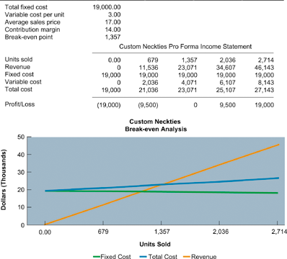
Essentials of Management Information Systems
Chapter 5 IT Infrastructure: Hardware and Software
What are the major types of computer software used in business and the major software trends?
Spreadsheet Software
Spreadsheet software organizes data into columns and rows for analysis and manipulation. Contemporary spreadsheet software provides graphing abilities for a clear, visual representation of the data in the spreadsheets. This sample break-even analysis is represented as numbers in a spreadsheet as well as a line graph for easy interpretation.
Figure 5.8
Notes:
Ask how many students use spreadsheets on a regular, daily basis? How many have never used spreadsheet software? Ask the users to describe how they use the software, what kinds of reports have they produced? What are the advantages of this software when compared to older methods—like calculating things by hand! What are the drawbacks of this software that they have personally witnessed.

Slide 35
Essentials of Management Information Systems
Chapter 5 IT Infrastructure: Hardware and Software
What are the major types of computer software used in business and the major software trends?
HTML and HTML5
Hypertext markup language (HTML):
  Page description language for specifying how elements are placed on a Web page and for creating links to other pages and objects
HTML5
  Next evolution of HTML
  Enables multimedia embedding without 3rd party plugins like Flash
Notes:
Many students probably do not know that you can see the HTML code of any Web page by the View/Page Source menu in Mozilla Firefox. You could demonstrate this during class.

Slide 36
Essentials of Management Information Systems
Chapter 5 IT Infrastructure: Hardware and Software
What are the major types of computer software used in business and the major software trends?
Web Services
Web services:
  Software components that exchange information with one another using universal Web communication standards and languages
  XML (eXtensible Markup Language)
    Foundation of Web services
  Service oriented architecture (SOA)
    Collection of services used to build an organization’s software systems
Notes:
Web services is an approach to building enterprise applications. Web services is a “messaging system” which allows diverse computing applications in a firm to communicate data with one another without extensive integration of the constituent applications (which tends to be very expensive). In a service-oriented architecture, various applications provide “services” (data) on request to other applications needing data. SOA is a major alternative to installing large scale enterprise systems.
Emphasize that SOA is a method of developing infrastructure using Web services with an eye toward creating applications that draw data from several underlying (usually older programs). All programs are built or redesigned to provide certain information (services) to all other programs. With SOA, developers incorporate each individual service into an application that successfully meets the needs of the organization.

Slide 37
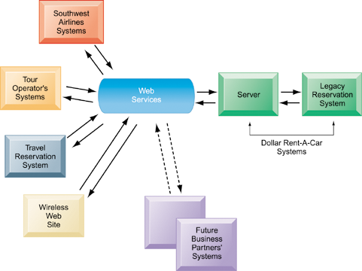
Essentials of Management Information Systems
Chapter 5 IT Infrastructure: Hardware and Software
What are the major types of computer software used in business and the major software trends?
How Dollar Rent-A-Car Uses Web Services
Dollar Rent-A-Car uses Web services to provide a standard intermediate layer of software to “talk” to other companies’ information systems. Dollar Rent-A-Car can use this set of Web services to link to other companies’ information systems without having to build a separate link to each firm’s systems.
Figure 5.9
Notes:
Dollar Rent-a-Car is an excellent example of how computer applications, some owned by different firms, can work together to provide a single environment for customers and users.

Slide 38
Essentials of Management Information Systems
Chapter 5 IT Infrastructure: Hardware and Software
What are the major types of computer software used in business and the major software trends?
Software Trends
Open source software
  Linux, Apache
Cloud-based software and tools
  SaaS (software as a service)
    Google Docs
  Mashups
    Zip Realty uses Google Maps and Zillow.com
  Apps
    Mobile apps
Notes:
Ask students to help you put together a list of really interesting software apps they have discovered or used in the last few months. Apple and Android have about 1.5 million apps each, a total of 3 million apps exist. How many apps do students have on their phones? The average is about 23 apps per phone. The top ten apps account for 90% of the usage. Facebook alone accounts for 50% of user smartphone time.

Slide 39
Essentials of Management Information Systems
Chapter 5 IT Infrastructure: Hardware and Software
What are the principal issues in managing hardware and software technology?
Capacity Planning and Scalability
Capacity planning
  Process of predicting when hardware system becomes saturated
  Ensuring firm has enough computing power for current and future needs
  Factors include:
    Maximum number of users
    Impact of current, future software
    Performance measures
Scalability: ability of system to expand to serve large number of users without breaking down
Notes:
One of the problems that firms face is the holidays when user demand for online services explodes, but then recedes after the holidays to a normal background level. Firms are forced to buy additional infrastructure to handle peak loads, which then sits idle after the holiday is over. One solution is to use cloud-based services to handle the peak loads of your firm, essentially renting extra capacity as needed. This solves the peak load problem and a part of the scalability problem—with cloud computing services you expand as needed without huge financial outlays.

Slide 40
Essentials of Management Information Systems
Chapter 5 IT Infrastructure: Hardware and Software
What are the principal issues in managing hardware and software technology?
Total Cost of Ownership (TCO) model
  Used to analyze direct and indirect costs to help determine the actual cost of owning a specific technology
    Direct costs: hardware, software purchase costs
    Indirect costs: ongoing administration costs, upgrades, maintenance, technical support, training, utility, and real estate costs
    Hidden costs: support staff, downtime, additional network management
  TCO can be reduced through increased centralization, standardization of hardware and software resources.
Notes:
Most students think of the “cost of computing” as the cost of the computer and the software. You could ask students to help you put together a list of all the additional costs that consumers face when purchasing a computer.

Slide 41
Essentials of Management Information Systems
Chapter 5 IT Infrastructure: Hardware and Software
What are the principal issues in managing hardware and software technology?
Using technology service providers
  Outsourcing
    Using external provider to:
      Run networks.
      Host, manage Web site(s).
      Develop software (offshore software outsourcing).
      Manage IT infrastructures.
    Requires Service Level Agreements (SLAs)
Notes:
One common answer to reducing the cost of computing hardware and software is to move the work off-shore to low wage countries like India and China. Thousands of U.S. and European firms outsource their programming work to low-wage countries. Even more firms outsource programming, systems analysis and design, and consulting work to onshore domestic firms. Nevertheless, computer and network jobs are abundant in the United States in part because more systems are being built than ever before (in part because building systems is less expensive than ever). As the costs of developing systems decline, the demand for systems grows stronger.

Slide 42
Essentials of Management Information Systems
Chapter 5 IT Infrastructure: Hardware and Software
What are the principal issues in managing hardware and software technology?
Using cloud services
  Small businesses “rent” infrastructure from provider to avoid expenses of maintaining hardware and software on their own.
  Hybrid cloud computing model
Managing mobile platforms
  Balancing gains in productivity from using mobile devices with expenses of equipping employees with these devices
  Mobile device management (MDM) software
Notes:
One way students can use cloud services is through Amazon Markets http://www.amazonservices.com/. Amazon provides cloud services to major business firms, and also to thousands of small merchants who want to use Amazon software to sell their goods and services. Take students to the Amazon site to demonstrate some of its capabilities.

Slide 43
Essentials of Management Information Systems
Chapter 5 IT Infrastructure: Hardware and Software
What are the principal issues in managing hardware and software technology?
Managing software localization for global business
  Local language interfaces
    English not typically standard at middle, lower levels
    Interfaces are complex: menu bars, error messages, online forms, search results, and so on
  Differences in local cultures
  Differences in business processes
All of these factors add to TCO of using technology service providers
Notes:
If you are operating in a global environment you can’t assume your employees will be able to understand English interfaces. An interesting niche business is software translation services. Do a search in class on “localization services” or go to http://www.ricintl.com/ Ric International translation services to illustrate for students how firms are translating their systems and localizing them (which is more than just translation).

